Slide 1

RED AND WHITE WINES AND MACHINE LEARNING
Ariel Matthews
& Brajon Andrews

Slide 2
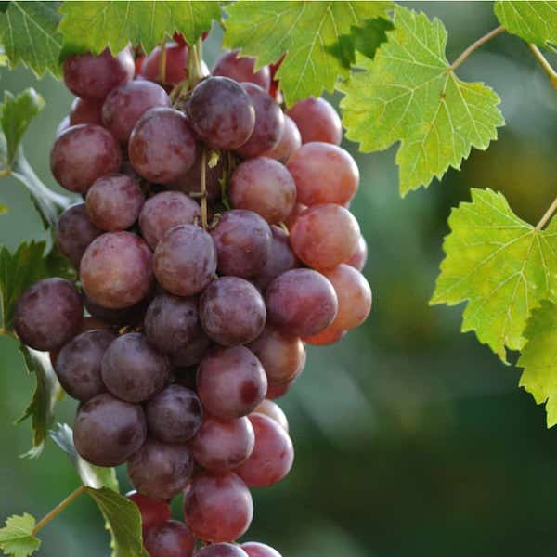
INTRODUCTION
We examined two data sets, one of 1,599 red wine records and the other of 4,898 white wine records.
We created our own hypotheses to ask and then used various machine learning models in order to try to answer those questions.

Slide 3

HYPOTHESIS #1
First, I wanted to look at the amount of residual sugar in red wine. This is the element of wine that classifies it on a spectrum of “dry” to “dessert” depending on how much sugar is left after the fermentation process. I wanted to determine whether the residual sugar amount has an impact on quality rating.
Hypothesis: The higher the amount of residual sugar, the lower the quality rating will be. I see many more dry red wines than dessert wines on restaurant menus, so perhaps sweeter wine is less valued by wine connoisseurs.

Slide 4
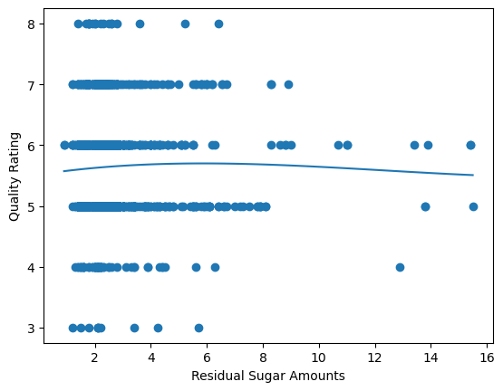
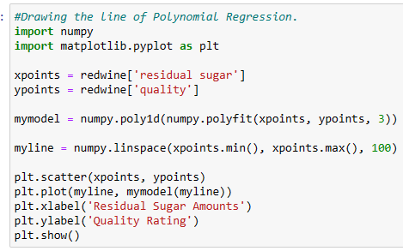
MODEL #1: POLYNOMIAL REGRESSION
In order to test my hypothesis out, I decided to use polynomial regression to examine the relationship between red wine residual sugar levels and quality rating. My variables are continuous so I felt they would be a good fit for the polynomial regression model. After importing the dataset into Jupyter Notebook and drawing the line of polynomial regression as below, I received an output graph:
The graph did not show that residual sugar amounts have an impact on the quality rating of red wine, so my hypothesis was disproven.

Slide 5
HYPOTHESIS #2
Second, I wanted to determine what characteristics red wines tend to have versus white wines, and then see if I could create a model that could predict if a wine was red or white based on a characteristic’s value. Through trial and error with histograms, I learned that most red wines in the dataset have residual sugar under 3 grams per liter, while only the white wines tended to have residual sugar levels over 7 grams per liter.
Hypothesis: If a wine has residual sugar well over 7 grams/liter, the model will predict it is a white wine.

Slide 6
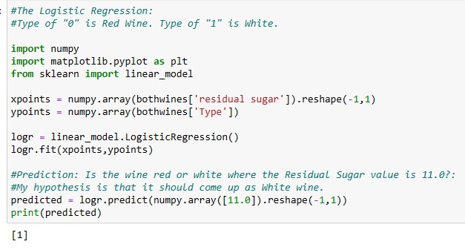
MODEL #2: LOGISTIC REGRESSION
In order to test my hypothesis out, I decided to use logistic regression to classify wines based on residual sugar levels. Logistic regression will return me a binomial result: that the wine is either red or white—based on the residual sugar levels in the combined dataset. Here is the logistic regression code and the output:
Here I fed into the model the combined red and white wine data, where Type of “0” is red and “1” is white. I asked the model to predict whether a wine with residual sugar levels of 11 would be red or white, and as I hypothesized, the model classified it as white with Type output of “1”.

Slide 7
HYPOTHESIS #3
Third, I wanted to examine this relationship between other red wine characteristics. I selected citric acid level and pH level.
Hypothesis: There will be a relationship between citric acid level and pH level, increased citric acid will make the wine’s pH become less basic.

Slide 8
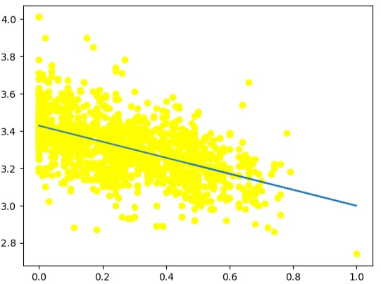
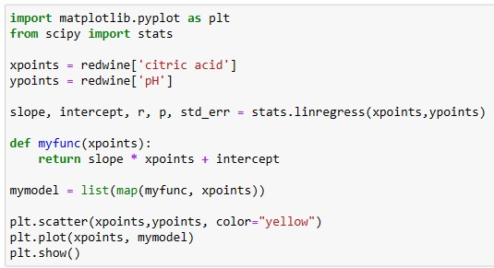
MODEL #3: LINEAR REGRESSION
In order to test my hypothesis out, I decided to use linear regression to examine the relationship between red wine citric acid and pH level. My variables are continuous & I felt their relationship would display change in a straightforward linear manner. After re-selecting the red wine data set and drawing the line of linear regression as below, I received an output graph:
The graph shows that as the citric acid level of the red wine increases, the pH value of the wine tends to decrease (the wine becomes less basic and more overall acidic.) This supports my hypothesis.

Slide 9
HYPOTHESIS #4
Fourth, I wanted to try using the model of K-Nearest Neighbors to try classifying wines again. From our logistic regression we know wines with higher residual sugar are usually white wines. From trial and error with histograms I discovered that red wines in this dataset have higher quality ratings.
Hypothesis: The K-Nearest Neighbors model will classify wines with high residual sugar & lower quality ratings as white, and wines with low residual sugar and higher quality ratings as red.

Slide 10
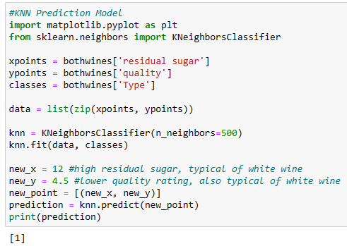
MODEL #4: KNN
In order to test my hypothesis out, I decided to use K-Nearest Neighbors for classification with the combined wines dataset. It would plot out all the wines’ residual sugar and quality ratings, then when I gave it a hypothetical wine with values for these items I make up, it will correctly classify that data point as red or white (I hope ☺)
Since the data set has about 6,000 wine records, I picked the number of neighboring wine data points to look at as 500, perhaps it should be higher? Nevertheless, my hypothetical wine with a high residual sugar rating and a low quality rating, both more typical of white wines, was correctly classified as such by the model.

Slide 11
ARIEL’S TAKEAWAYS
For me:
It was difficult trying to find variables that had any type of relationship to analyze, it took a lot of trial and error with r and r-squared values for me to find variables that had impacts on each other I could graph. I guess a finding of no relationship is still a finding but it was more difficult than I thought it would be.
For a viewer: Red and white wines show distinctness from each other, but their unique characteristics have no impact on their quality. Enjoy the type you love!

Slide 12
HYPOTHESIS #5
Fifth, I wanted to examine the amount of alcohol in red wines and determine if it has an impact on the taste and quality rating assigned to each white wine by wine experts. It is important to note that the quality score is subjective, as individual preferences and tastes can vary greatly. Additionally, other factors such as grape variety, winemaking techniques, and regional characteristics also contribute to the overall quality of the wine.
Hypothesis: The amount of alcohol in red wine has a significant impact on its perceived quality grade.

Slide 13
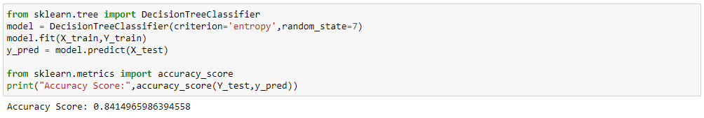
MODEL #5: Decision Tree
In order to test my hypothesis out. I ran the algorithms on the red wine data set. We classified high quality wine as having a quality score greater than or equal to 7. Here is the decision tree code and the output:

Slide 14
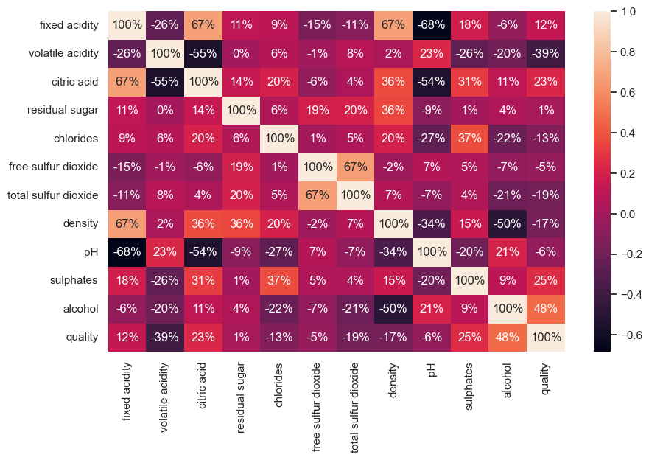
Red Wine Correlation Heat Map
The attribute with the coefficient in relation to the quality was alcohol.

Slide 15
HYPOTHESIS #6
Sixth, I wanted to examine the amount of alcohol in white wines and determine if it has an impact on the taste and quality rating assigned to each white wine by wine experts. It is important to note that the quality score is subjective, as individual preferences and tastes can vary significantly. Additionally, other factors such as grape variety, winemaking techniques, and regional characteristics also contribute to the overall quality of the wine.
Hypothesis: The amount of alcohol in white wine has a significant impact on its perceived quality grade.

Slide 16
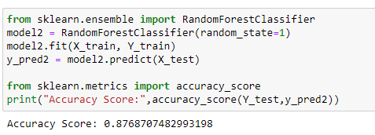
MODEL #6: Random Forest
In order to test my hypothesis out, I ran the algorithms separately on both the red and white data sets. We classified high quality wine as the quality score being greater than or equal to 7. Here is the random forest tree code and the output:

Slide 17
White Wine Correlation Heat Map
The attribute with the coefficient in relation to the quality was alcohol.

Slide 18
Brajon’s TAKEAWAYS
For me:
Among the attributes considered in the dataset, the alcohol content in both red and white wine has a direct influence on the quality rating given by experts. Alcohol plays a significant role in various sensory aspects of wine, such as its taste, mouthfeel, and aroma. This assertion was supported by our findings from two separate hypotheses conducted on distinct wine datasets.
For a viewer: Alcohol content is just one aspect of wine quality. There are other factors that contribute towards the wine quality.

